Slide 1
CSC 810: Artificial Intelligence
Week 2
Search Techniques &
Problem Solving Strategies
BFS · DFS · Heuristic Search · A*
Lecturer Note ▸ 2 Lecture Hours + 2 Practical Hours (Google Colab)
Russell & Norvig Ch. 3–4 | AI: A Modern Approach (4th ed.)

Slide 2
📋 Week 2 at a Glance
🔍 What is Search in AI?
🗺️ Problem-Solving Framework
Why search matters, problem formulation
States, actions, goal test, path cost
🌲 Uninformed Search
⭐ Informed Search
BFS — Depth-First Search (DFS)
Greedy Best-First, A* algorithm
📡 AI Search Applications
💻 Google Colab Lab
Routing, game trees, planning
Implement BFS, DFS and A* in Python

Slide 3
🔍 What is Search in AI?
Search is how an AI agent finds a sequence of actions to reach a goal from an initial state.
Initial
State
Search
Algorithm
Explored
States
Goal
State ✓
Real-World Examples
🗺️ Google Maps
Finds shortest path between locations
♟️ Chess AI
Searches game tree for best move
📦 Delivery Robot
Plans route avoiding obstacles
🧩 Puzzle Solver
Finds sequence of moves to solve

Slide 4
🗺️ Problem Formulation — The 5 Components
Before we search, we must formally define the problem.
1
Initial State
2
Actions
3
Transition Model
Where the agent starts
e.g. Abuja (Nigeria route-finding)
Possible moves from each state
e.g. Go(Abuja → Lokoja)
Result of applying an action
e.g. Result(Abuja, Go-Lokoja) = Lokoja
4
Goal Test
5
Path Cost
Is the current state the goal?
e.g. In(Lagos)
Total cost of the solution path
e.g. sum of road distances (km)

Slide 5
🌊 Breadth-First Search (BFS)
Uninformed Search
BFS Properties
A
Level 0
Complete?
✅ Yes (finds a solution if it exists)
Optimal?
✅ Yes (shortest path in unweighted graphs)
B
C
Level 1
Time Complexity
O(b^d) — b=branching, d=depth
D
E
F
G
Space Complexity
O(b^d) — keeps all nodes in memory
Level 2 (Goal!)
Data Structure
🗃️ Queue (FIFO)
Order visited: A → B → C → D → E → F → G ✓
Best for
Shallow goals / unweighted graphs
Explores all nodes level by level — closest nodes first.

Slide 6
🕳️ Depth-First Search (DFS)
Uninformed Search
①
DFS Properties
A
Complete?
⚠️ No (fails in infinite-depth spaces)
②
Optimal?
❌ No (may find suboptimal path)
B
C
Time Complexity
O(b^m) — m=max depth
③
D
E
F
G
Space Complexity
O(bm) — only current path in memory
④
Data Structure
📚 Stack (LIFO)
H
Explores as deep as possible along each branch before backtracking.
Best for
Deep goals / memory-constrained settings
DFS dives deep: A→B→D→H (backtracks if stuck)

Slide 7
⚖️ BFS vs DFS — Side-by-Side
Property
BFS
DFS
Data Structure
Queue (FIFO)
Stack (LIFO)
Order
Level by level
Branch by branch
Completeness
✅ Always
⚠️ Only finite spaces
Optimality
✅ Unweighted graphs
❌ Not guaranteed
Memory Usage
High (stores all nodes)
Low (stores current path)
Speed
Slow for deep goals
Fast for deep goals
Use Case
Shortest path
Maze, tree traversal

Slide 8
⭐ Informed Search — Heuristics & A*
Informed Search
Uses problem-specific knowledge (heuristics) to guide the search toward the goal more efficiently.
What is a Heuristic? h(n)
A* Formula
An estimate of the cost from node n to the goal.
Must be admissible: never overestimate actual cost.
f(n) = g(n) + h(n)
g(n) = cost so far h(n) = estimated cost to goal
How A* Works — Step by Step
①
Start at initial node. Put it in the OPEN list with f(start) = g(start) + h(start)
②
Pick the node with the lowest f(n) from OPEN. If it's the goal → done!
③
Move it to CLOSED. Expand its neighbors; calculate f(n) for each.
④
Add neighbors to OPEN if not already visited (or update if better path found).
⑤
Repeat from step ② until goal is found or OPEN is empty (no solution).

Slide 9
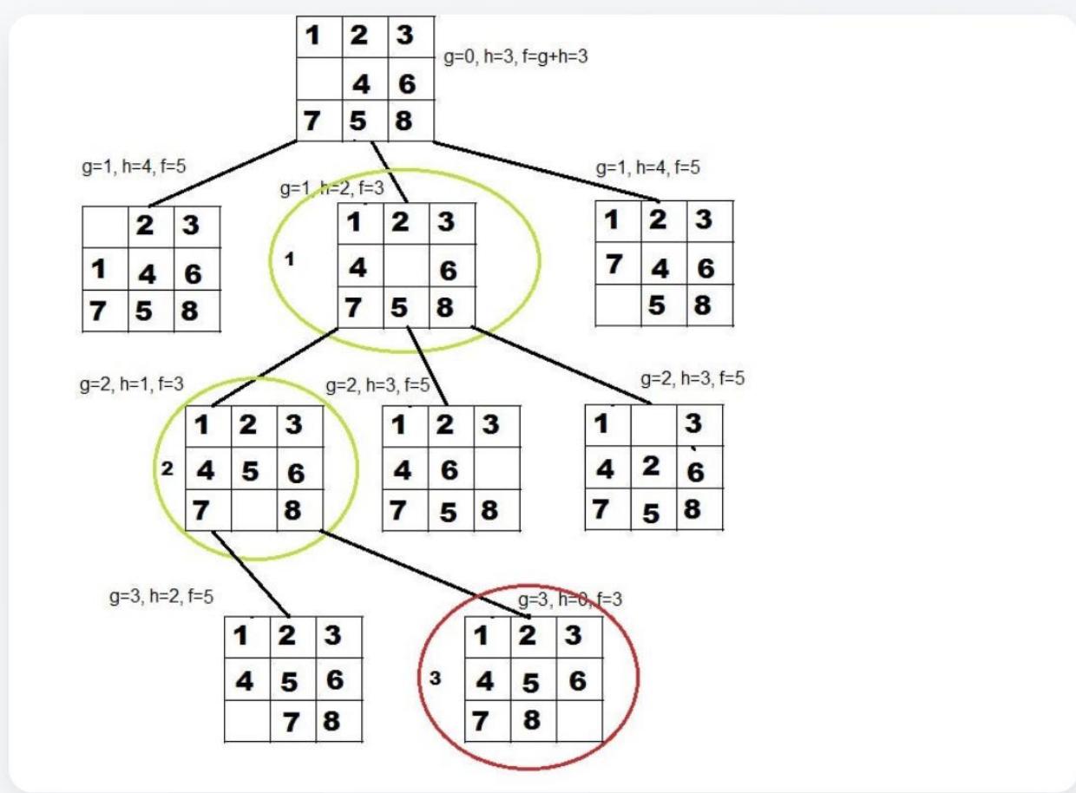
⭐ Informed Search — Heuristics & A*
Informed Search
Uses problem-specific knowledge (heuristics) to guide the search toward the goal more efficiently.
f(n) = g(n) + h(n)
A* Formula
g(n) = cost so far h(n) = estimated cost to goal
How A* Works — Step by Step
Start at initial node. Put it in the OPEN list with f(start) = g(start) + h(start)
Pick the node with the lowest f(n) from OPEN. If it's the goal → done!
Move it to CLOSED. Expand its neighbors; calculate f(n) for each.
Add neighbors to OPEN if not already visited (or update if better path found).
Repeat from step ② until goal is found or OPEN is empty (no solution).

Slide 10
🇳🇬 Classic A* Search Example: Nigeria Route-Finding
Kaduna
Lafia
A* Result
Goal: Find the shortest road path from Abuja to Lagos
h(n) = approximate straight-line distance to Lagos (admissible heuristic)
Path Found:
Abuja →
Lokoja →
Ibadan →
Lagos ✓
Total: ~618 km
(Optimal Path)
★ Best path highlighted in orange · Distances are approximate road km

Slide 11
📊 Search Algorithms — Full Comparison
Algorithm
Complete?
Optimal?
Time
Space
Uses Heuristic?
BFS
✅ Yes
✅ Yes (unweighted)
O(b^d)
O(b^d)
❌ No
DFS
⚠️ Finite
❌ No
O(b^m)
O(bm)
❌ No
Depth-Limited
⚠️ Yes
❌ No
O(b^l)
O(bl)
❌ No
Iterative Deep.
✅ Yes
✅ Yes (unweighted)
O(b^d)
O(bd)
❌ No
Greedy Best-F.
⚠️ Yes
❌ No
O(b^m)
O(b^m)
✅ Yes
A*
✅ Yes
✅ Yes (admissible h)
O(b^d)
O(b^d)
✅ Yes
⭐ A* is the gold standard for informed search — complete, optimal, and efficient when h(n) is admissible.

Slide 12
💻 Practical Lab
Google Colab Exercises
Lab 1
Implement BFS from Scratch
~20 min
Lab 2
Implement DFS from Scratch
~15 min
Lab 3
A* Search on Nigeria Road Map
~25 min
Bonus
Visualize Search with NetworkX
~15 min
Open Colab: colab.research.google.com · Sign in with Google · New Notebook

Slide 13
💻 Lab 1 — Implement BFS in Python (Colab)
Lab 1 of 3
Task: Find path from 'A' to 'G' in a sample graph using BFS
from collections import deque
graph = {
'A': ['B', 'C'],
'B': ['D', 'E'],
'C': ['F', 'G'],
'D': [], 'E': [], 'F': [], 'G': []
}
def bfs(graph, start, goal):
queue = deque([[start]]) # queue of PATHS
visited = set()
while queue:
path = queue.popleft() # get next path
node = path[-1] # current node
if node == goal:
return path # FOUND! return path
if node not in visited:
visited.add(node)
for neighbor in graph[node]:
new_path = path + [neighbor]
queue.append(new_path)
return None # no path found
result = bfs(graph, 'A', 'G')
print("BFS Path:", result)
# Expected output: BFS Path: ['A', 'C', 'G']
✏️ Your Exercises
1. Run the code — what path does BFS return?
2. Add a node 'H' connected to 'D'. Does BFS still find the shortest path?
3. Change goal to 'E'. What is the new path?
4. Count how many nodes BFS visits before finding the goal.
5. CHALLENGE: Modify BFS to work on a weighted graph (ignore weights for now).

Slide 14
💻 Lab 2 — Implement DFS in Python (Colab)
Lab 2 of 3
Task: Find path from 'A' to 'G' using DFS — notice the difference from BFS!
graph = {
'A': ['B', 'C'],
'B': ['D', 'E'],
'C': ['F', 'G'],
'D': [], 'E': [], 'F': [], 'G': []
}
def dfs(graph, start, goal, path=None, visited=None):
if path is None: path = [start]
if visited is None: visited = set()
if start == goal:
return path # FOUND!
visited.add(start)
for neighbor in graph[start]:
if neighbor not in visited:
result = dfs(graph, neighbor, goal,
path + [neighbor], visited)
if result:
return result
return None # dead end — backtrack
result = dfs(graph, 'A', 'G')
print("DFS Path:", result)
# DFS Path: ['A', 'B', 'D', ...] or ['A', 'C', 'G']
# (depends on graph order — DFS goes DEEP first!)
✏️ Compare BFS vs DFS
1. Run DFS. Which path does it return?
2. Is DFS's path the shortest? Why/why not?
3. Add 'A': ['C', 'B'] (swap order). What changes?
4. Try a graph with a cycle — does DFS get stuck? Fix it!
5. CHALLENGE: Implement iterative DFS using a Stack (list) instead of recursion.

Slide 15
💻 Lab 3 — A* Search: Abuja to Lagos (Colab)
Lab 3 of 3
Task: Use A* to find the optimal road route from Abuja to Lagos using straight-line distance as h(n)
import heapq
# Straight-line distances to Lagos (heuristic h(n), in km)
h = {
'Abuja':530, 'Kaduna':660, 'Lafia':545,
'Lokoja':380, 'Okene':320, 'Benin':275,
'Ibadan':128, 'Lagos':0
}
# Road network: (neighbor, road_distance_km)
graph = {
'Abuja': [('Kaduna',185),('Lafia',170),('Lokoja',180)],
'Kaduna': [('Abuja',185),('Lokoja',310)],
'Lafia': [('Abuja',170)],
'Lokoja': [('Abuja',180),('Kaduna',310),
('Okene',82),('Ibadan',310)],
'Okene': [('Lokoja',82),('Benin',150)],
'Benin': [('Okene',150),('Lagos',340)],
'Ibadan': [('Lokoja',310),('Lagos',128)],
'Lagos': [('Ibadan',128),('Benin',340)],
}
def astar(start, goal):
open_list = [(h[start], 0, start, [start])]
visited = set()
while open_list:
f, g, node, path = heapq.heappop(open_list)
if node == goal: return path, g
if node in visited: continue
visited.add(node)
for neighbor, cost in graph.get(node, []):
if neighbor not in visited:
ng = g + cost
nf = ng + h.get(neighbor, 0)
heapq.heappush(open_list,
(nf, ng, neighbor, path+[neighbor]))
return None, float('inf')
path, cost = astar('Abuja', 'Lagos')
print(f"Path: {path}")
print(f"Total distance: {cost} km")
# Expected: Abuja → Lokoja → Ibadan → Lagos (~618 km)
✏️ Exercises
1. Run A*. Which path does it return?
2. Is Abuja→Lokoja→Ibadan→Lagos optimal? Why?
3. Set h('Lokoja') = 0. Does A* still find the best path?
4. Remove the Ibadan route — what new path does A* find?
5. CHALLENGE: Add Ilorin (Lokoja→Ilorin: 190km, Ilorin→Lagos: 300km) and rerun.

Slide 16
🎯 Week 2 Key Takeaways
🔍 Search is fundamental
AI uses search to find sequences of actions that lead from an initial state to a goal state.
🌊 BFS = Breadth first
Explores level by level. Complete & optimal (unweighted). Uses a Queue. High memory.
🕳️ DFS = Depth first
Explores deep before wide. Low memory but not optimal. Uses a Stack or recursion.
⭐ A* = Best of both
Uses f(n) = g(n) + h(n). Complete and optimal when h(n) is admissible. The go-to algorithm.
📐 Heuristics matter
A good h(n) can dramatically speed up A*. Bad heuristics can make it slower than BFS.
📖 Reading: Russell & Norvig Ch. 3 (Uninformed) & Ch. 4 (Informed)

